Slide 1
Construct the Keyword Dictionary based on News Texts

Slide 2
References
M. Yamamoto, K. Church: Using Suffix Arrays to Compute Term Frequency and Document Frequency for All Substrings in a Corpus, Computational Linguistics, 27(1), pp. 1 – 30.
http://www.matrix67.com/blog/archives/5044

Slide 3
Data
The news corpus:
1.6 GB, 330,000 documents in total.
Divided into 16 parts, containing approx. 20,000 documents in each part
Process the parts in parallel, and then sum up the results for further processing.

Slide 4
Word Extraction
Step 1: Count the substrings
Enumerate every substring shorter than 7 in a sentence (composed of a sequence of Chinese characters)
Count the occurrence.

Slide 5
Word Extraction
Step 2: Find neighborhood characters set
For each substring s shorter than 5, find in the substring repository another substring t that contains s, and then add the left and right neighborhood characters of s in t to two sets respectively.
e.g. 吃葡萄不吐葡萄皮不吃葡萄倒吐葡萄皮
For substring s = “葡萄”, its left-neighborhood character set = {‘吃’, ‘吐’, ‘吃’, ‘吐’}, and the set for right is {‘不’, ‘皮’, ‘倒’, ‘皮’}.

Slide 6
Word Extraction
Step 2: Find neighborhood characters set
For substring s = “葡萄”, its left-neighborhood character set = {‘吃’, ‘吐’, ‘吃’, ‘吐’}, and the set for right is {‘不’, ‘皮’, ‘倒’, ‘皮’}.
Compute information entropy on both sets
We get: 1/2log2 + 1/2log2 = 1 for the left, and 1/4log4 + 1/2log2 + 1/4log4 = 1.5 for the right.
Conserve only those having entropy larger than a given threshold. In our case it is set to 1.0.

Slide 7
Build a Dictionary for CWS
Step 3: Output the remaining substrings and their frequencies.
Build up the temporary dictionary for rough word segmentation.
Step 4: Perform rough word segmentation on the news corpus.
Get documents segmented. Many noise substrings may exist.

Slide 8
Eliminating Noise Substrings
In the temporary dictionary, there may exist many substrings which are not exactly words or phrases. They are fragments of a sentence like “和资本市场”, which also enjoy high frequency. We call them noise substrings.
To eliminate these noise, we suppose that such phrases are stereotyped news fragments.

Slide 9
Take Temporal Sequence into Account
We may reason that news clichés repeat themselves so often that their frequency do not vibrate much in time.
Thus, a fragment may be outstanding in one document, but it will not when comparing with other documents. Then we can build up a dictionary consisting of only distinct words in all time.

Slide 10
Bayesian Average
We here introduce Bayesian average for finding out outstanding words.
To score the distinctness, we keep in record the global average frequency f and total words count t till the time we meet with a new document, and then depict the distinctness by evaluating (f+w)/(t+c), where w is the word frequency of some word in the current document D, and c is the total word count of D.

Slide 11
Accumulation over Time
Thus, only those words much more frequent than those in previous documents may occur in the Bayesian average result. We call them keywords.
And we sum up the frequency of those keywords, and again conserve only those occurred more than the given threshold.

Slide 12
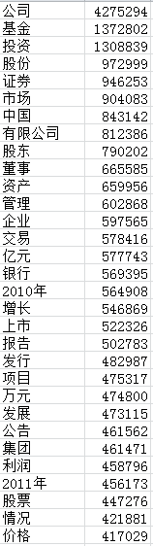
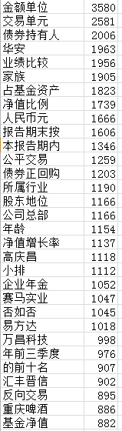
Results
In the original result (left), some highly frequent words (we may ignore them) ranked high;
In the processed result (right), we preserved keywords (those we have interest in) only.

Slide 13
Clustering over selected words (I)
1280 words formed the dictionary
Cluster using Gaussian Means and Spectral Means
972 documents (one for a day) in total

Slide 14
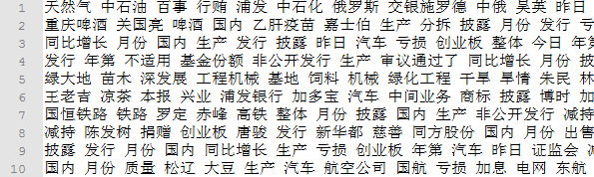
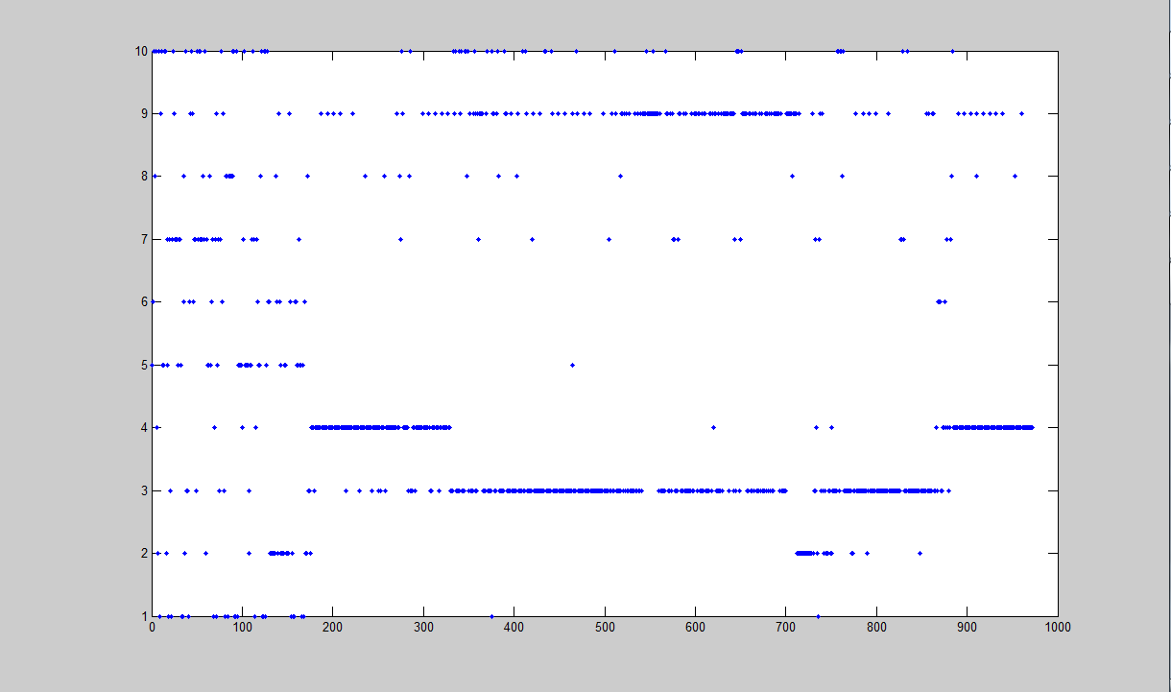
Clustering over selected words (I)
Spectral means, 10 clusters

Slide 15
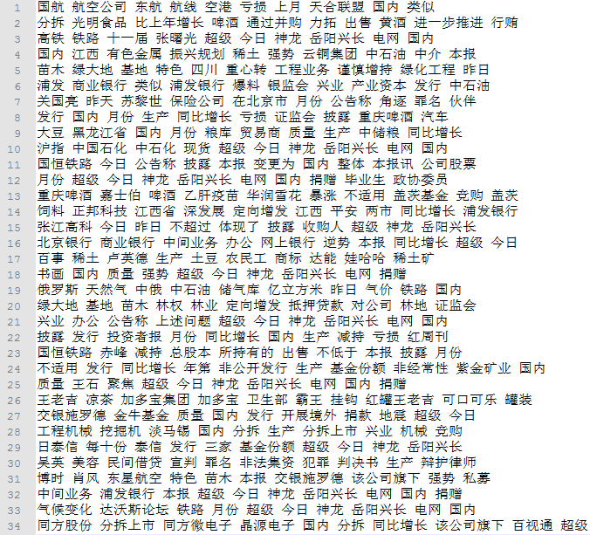
Gaussian means, 119 clusters

Slide 16
Clustering over selected words (II)
One document for each stock
Imposed on S12 and S50

Slide 17
(Results to be added)

